Slide 1


<Rim Azaouzi>
<05/09/2023>

Slide 2

Outline
Executive Summary
Introduction
Methodology
Results
Conclusion
Appendix

Slide 3
Executive Summary
Data have been Collected data from public SpaceX API and SpaceX Wikipedia page. Basic data wrangling and formatting and dealing with missing values and webscraping were made. Data was explored using SQL, visualization, folium maps, and dashboards. Data was cleaned and processed in order to better answer the questions. labels column ‘class’ which classifies successful landings were created and gathered relevant columns to be used as features. Changed all categorical variables to binary using one hot encoding. Standardized data and used GridSearchCV to find best parameters for machine learning models. Visualize accuracy score of all models.
Results showed that the four machine learning models were produced: Logistic Regression, Support Vector Machine, Decision Tree Classifier, and K Nearest Neighbors. All produced similar results with accuracy rate of about 83.33%. All models over predicted successful landings. More data is needed for better model determination and accuracy.

Slide 4
Introduction
Background:
Space commercials
Space X has the best pricing ($62 million vs. $165 million USD)
First Stage can be recovered (Stage 1)
Competitors can use this information to compete with Space X in launching rocket
Problem:
How to know the right price to bid against SpaceX for a rocket launch?
How to predict a successful recovery of the first stage using machine learning tool by
Identifying factors influencing the landing outcome, their relationship and the effect on the outcome, How to increase the probability of successful landing

Slide 5

Section 1

Slide 6
Methodology
Executive Summary
Data collection methodology:
Combined data from SpaceX public API and SpaceX Wikipedia page
Perform data wrangling
Data was processed using one-hot encoding for categorical features and Classifying true landings as successful and unsuccessful otherwise
Perform exploratory data analysis (EDA) using visualization and SQL
Perform interactive visual analytics using Folium and Plotly Dash
Perform predictive analysis using classification models
Tuned models using GridSearchCV

Slide 7
Data Collection
Rocket launch data sets were collected of from SpaceX API and SpaceX Wikipedia page
For REST API was made by using the get request. Then, we decoded the response content as Json and turn it into a pandas dataframe using json_normalize(). Data were cleaned the data, checked for missing values and fill with whatever needed.
For web scrapping, we will use the BeautifulSoup to extract the launch records as HTML table, parse the table and convert it to a pandas dataframe for further analysis

Slide 8
Data Collection – SpaceX API
Request (Space X APIs)
.JSON file + Lists(Launch Site, Booster Version, Payload Data)
Json_normalize to DataFrame data from JSON
Github url:
https://github.com/ramroumette/Capstone-project-coursera/blob/main/Complete%20the%20Data%20Collection%20API%20Lab.ipynb
Filter data to only include Falcon 9 launches
Cast dictionary to a DataFrame
Dictionary relevant data
Imputate missing values with mean

Slide 9
Data Collection - Scraping
Request Wikipedia html
BeautifulSoup html5lib Parser
Find launch info html table
Create dictionary
Iterate through table cells to extract data to dictionary
Cast dictionary to DataFrame
Github url:
https://github.com/ramroumette/Capstone-project-coursera/blob/main/Complete%20the%20Data%20Collection%20with%20Web%20Scraping%20lab.ipynb

Slide 10
Data Wrangling
Data Wrangling is the process of cleaning and unifying messy and complex data sets for easy access and Exploratory Data Analysis (EDA).
Firstly, the cacluation of number of launches on each site, calculate the number and occurrence of mission outcome per orbit type.
We then create a landing outcome label from the outcome column. This will make it easier for further analysis, visualization, and ML.
Github url:
https://github.com/ramroumette/Capstone-project-coursera/blob/main/Data%20Wrangling.ipynb

Slide 11
EDA with Data Visualization
Visualization tools are used to better explore the data and it was performed on variables Flight Number, Payload Mass, Launch Site, Orbit, Class and Year.
Plots Used:
Flight Number vs. Payload Mass, Flight Number vs. Launch Site, Payload Mass vs. Launch Site, Orbit vs. Success Rate, Flight Number vs. Orbit, Payload vs Orbit, and Success Yearly Trend
Scatter plots, line charts, and bar plots were used to compare relationships between variables to
Github url:
https://github.com/ramroumette/Capstone-project-coursera/blob/main/EDA%20with%20Visualization.ipynb

Slide 12
EDA with SQL
Many queries to get better understanding of the dataset with SQL,
- Displaying the names of the launch sites.
- Displaying 5 records where launch sites begin with the string ‘CCA’.
- Displaying the total payload mass carried by booster launched by NASA (CRS).
- Displaying the average payload mass carried by booster version F9 v1.1.
- Listing the date when the first successful landing outcome in ground pad was achieved.
- Listing the names of the boosters which have success in drone ship and have payload mass
greater than 4000 but less than 6000.
- Listing the total number of successful and failure mission outcomes.
- Listing the names of the booster_versions which have carried the maximum payload mass.
- Listing the failed landing_outcomes in drone ship, their booster versions, and launch sites
names for in year 2015.
- Rank the count of landing outcomes or success between the date 2010-06-04 and
2017-03-20, in descending order.
Github url:
https://github.com/ramroumette/Capstone-project-coursera/blob/main/EDA%20with%20SQL.ipynb

Slide 13
Build an Interactive Map with Folium
In order to locate successful and unsuccessful landings, and a proximity example to key locations: Railway, Highway, Coast, and City, the folium maps mark was used and added a circle marker around each launch site with a label of the name of the launch site..
The dataframe launch_outcomes(failure,success) to classes 0 and 1 with Red and Green markers on the map in MarkerCluster().
Github url:
https://github.com/ramroumette/Capstone-project-coursera/blob/main/Interactive%20Visual%20Analytics%20with%20Folium%20lab.ipynb

Slide 14
Build a Dashboard with Plotly Dash
An interactive dashboard with Plotly dash which allow user to play around with the data as they need.
• Pie charts showing the total launches by a certain sites.
• Scatter plot graph showing the relationship with Outcome and Payload Mass (Kg) for the different booster version.
Github url:
https://github.com/ramroumette/Capstone-project-coursera/blob/main/Build%20an%20Interactive%20Dashboard%20with%20Ploty%20Dash.py

Slide 15
Predictive Analysis (Classification)
Building the Model
Evaluating the Model
Improving the Model
Find the Best Model
Load the dataset into
NumPy and Pandas
Transform the data and
then split into training and
test datasets
Decide which type of ML is best
set the parameters and
algorithms to GridSearchCV
and fit it to dataset
•Check the accuracy for each model
•Get tuned hyper-parameters for each type of algorithms.
•plot the confusion matrix.
Feature Engineering
and Algorithm Tuning
The model with the best
accuracy score will be the best performing model
Github url:
https://github.com/ramroumette/Capstone-project-coursera/blob/main/Complete%20the%20Machine%20Learning%20Prediction.ipynb

Slide 16
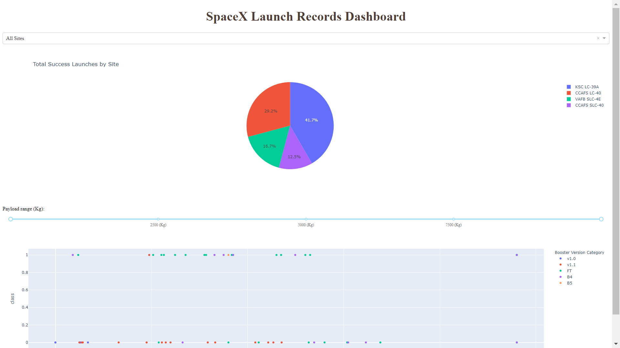
Results
Plotly dashboard. Result as shown in the figure.
The following sides will show the results of EDA with visualization, EDA with SQL, Interactive Map with Folium, and finally the results of our model with about 83% accuracy.

Slide 17

Section 2

Slide 18
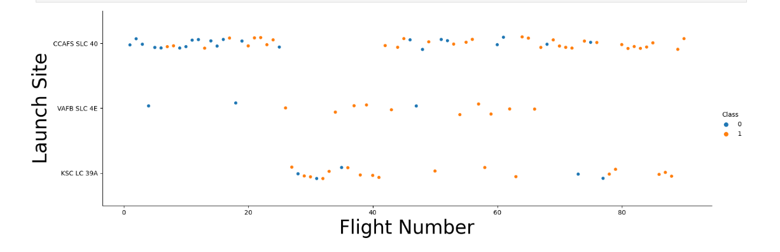
Flight Number vs. Launch Site
This scatter plot shows that the larger the flights amount of the launch site, the greater the success rate will be. However, site CCAFS, SLC40 shows the least pattern of this.

Slide 19
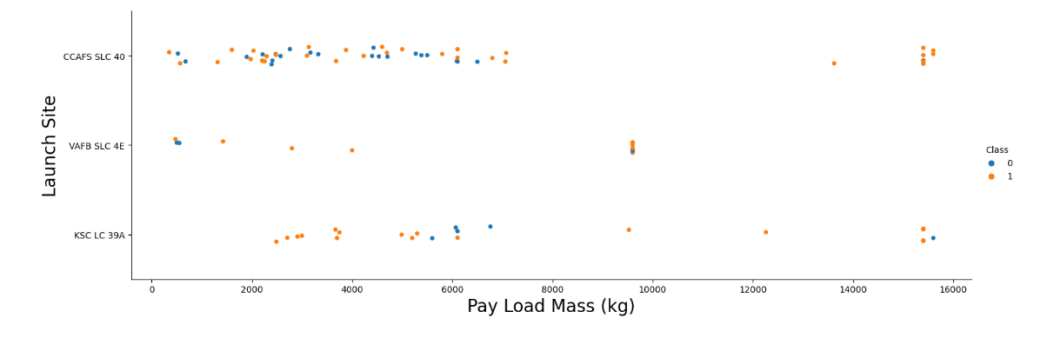
Payload vs. Launch Site
If the pay load mass is greater than 7000kg, the probability of the success rate will be highly increased.
However, there is no clear pattern to say the launch site is dependent to the pay load mass for the success rate.

Slide 20
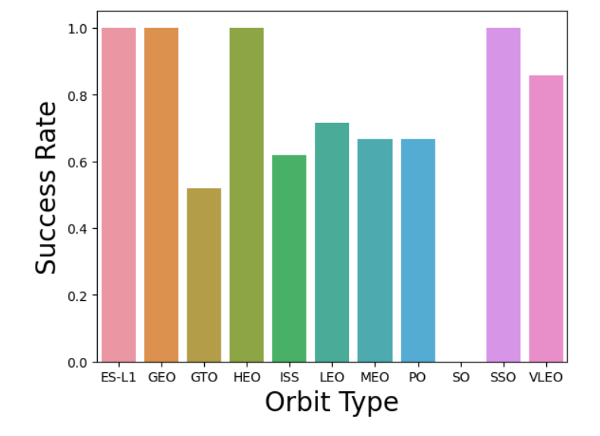
Success Rate vs. Orbit Type
the orbits influence the landing outcomes
as some orbits has 100% success rate such as SSO, HEO, GEO AND ES-L1 while SO orbit produced
0% rate of success.
However, deeper analysis show that some of this orbits has only 1 occurrence such as GEO, SO,
HEO and ES-L1 which mean this data need more dataset to see pattern or trend.

Slide 21
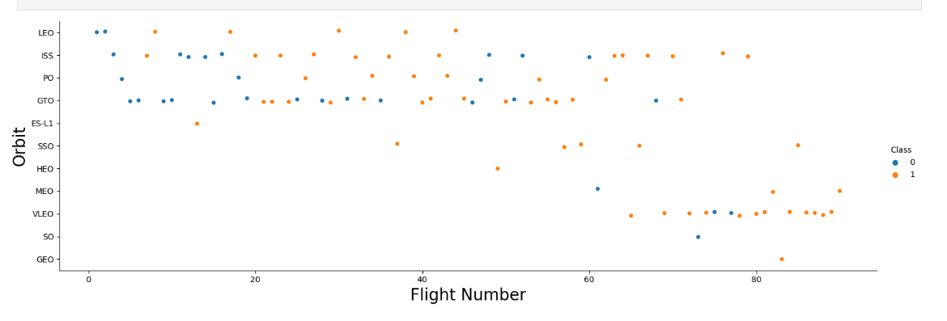
Flight Number vs. Orbit Type
the larger the flight number on each orbits, the greater the success rate (especially LEO orbit) except for GTO orbit which depicts no relationship between both attributes.
Orbit that only has 1 occurrence should also be excluded from above statement as it’s needed more dataset.

Slide 22
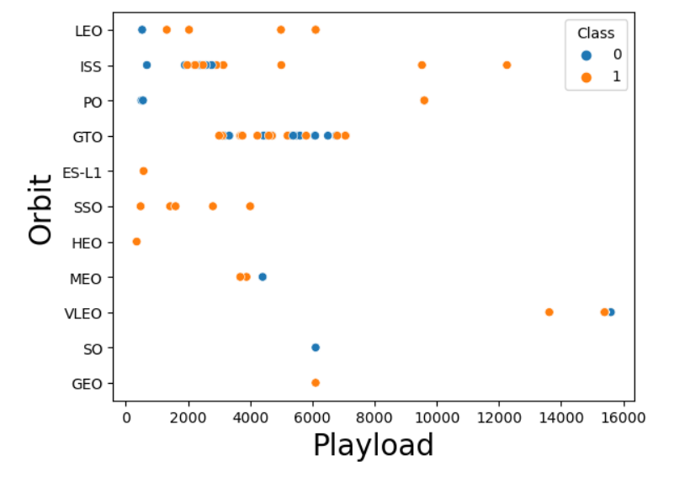
Payload vs. Orbit Type
Heavier payload has positive
impact on LEO, ISS and P0 orbit.
However, it has negative impact
on MEO and VLEO orbit.
GTO orbit seem to depict no
relation between the attributes.
Meanwhile, again, SO, GEO and
HEO orbit need more dataset to
see any pattern or trend.

Slide 23
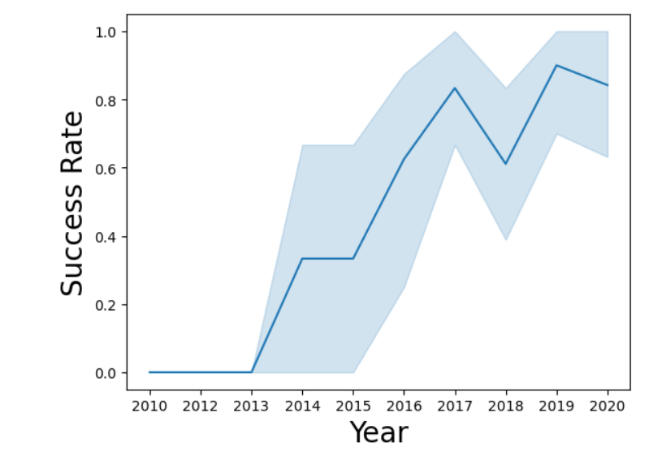
Launch Success Yearly Trend
This figures clearly depicted and increasing trend from the year 2013 until 2020.
If this trend continue for the next year onward. The success rate will steadily
increase until reaching
1/100% success rate

Slide 24
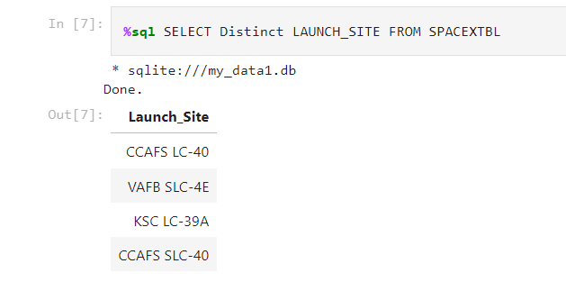
All Launch Site Names
Query unique launch site names from database.
CCAFS SLC-40 and CCAFSSLC-40 likely all represent the same
launch site with data entry errors.
CCAFS LC-40 was the previous name. Likely only 3 unique launch_site values: CCAFS SLC-40, KSC LC-39A, VAFB SLC-4E

Slide 25
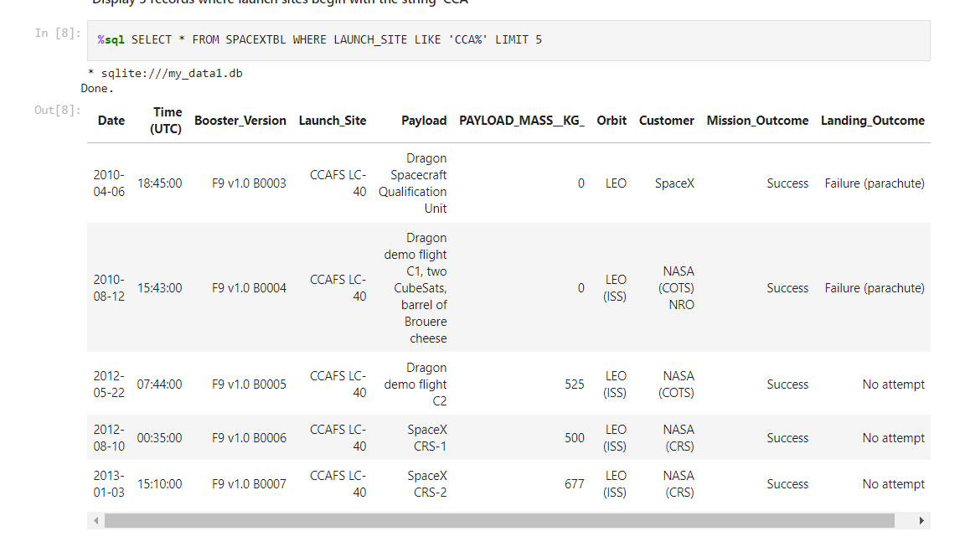
Launch Site Names Begin with 'CCA'
First five entries in database with Launch Site name beginning with CCA.

Slide 26
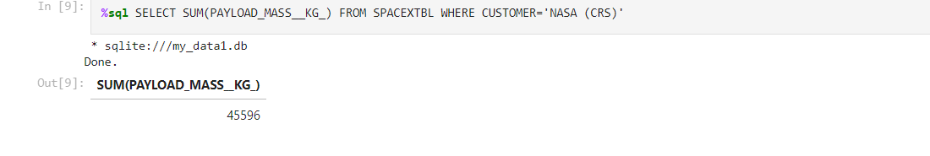
Total Payload Mass
We calculated the total payload carried by boosters from NASA as 45596 using the query below

Slide 27
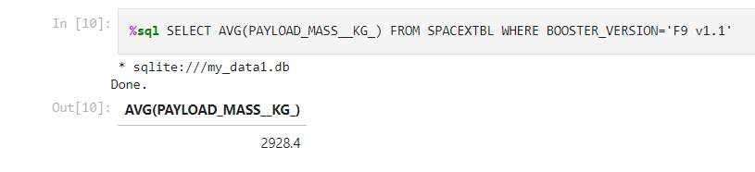
Average Payload Mass by F9 v1.1
We calculated the average payload mass carried by booster version F9 v1.1 as 2928.4

Slide 28
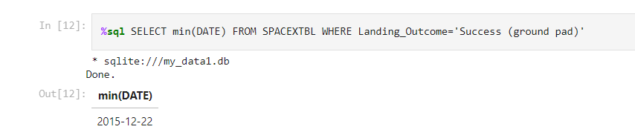
First Successful Ground Landing Date
We use the min() function to find the result
We observed that the dates of the first successful landing outcome on groundpad was 22nd December 2015

Slide 29
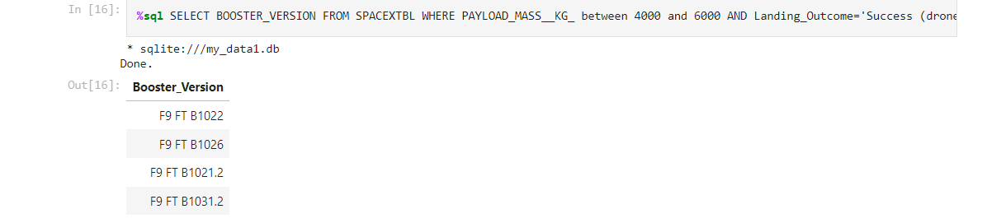
Successful Drone Ship Landing with Payload between 4000 and 6000
We used the WHERE clause to filter for boosters which have successfully landed on drone ship and applied the AND condition to determine successful landing with payload mass greater than 4000 but less than 6000

Slide 30
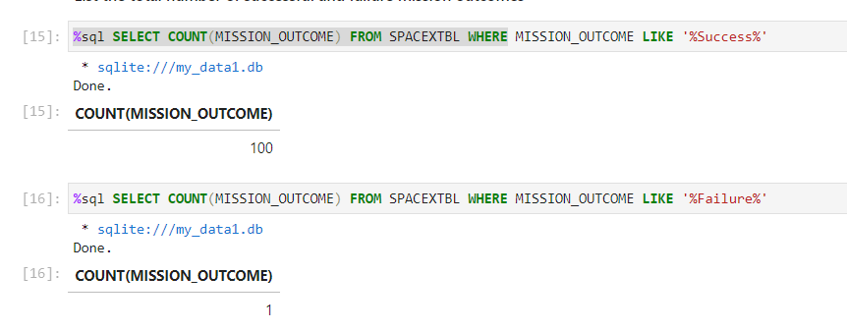
Total Number of Successful and Failure Mission Outcomes
We used wildcard like ‘%’ to filter for WHERE MissionOutcome was a success or a failure.

Slide 31
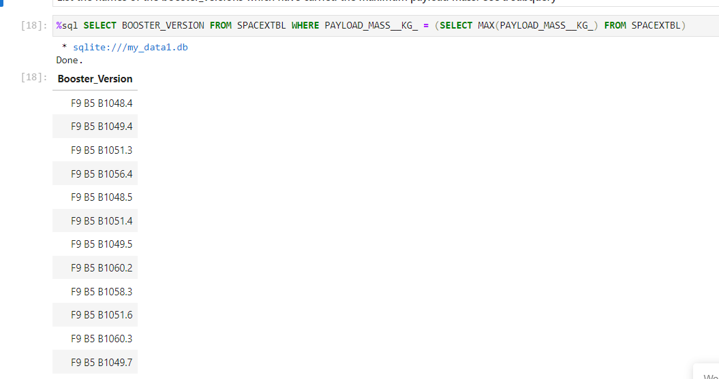
Boosters Carried Maximum Payload
This query returns the booster versions that carried the highest payload mass of 15600 kg.
These booster versions are very similar and all are of the F9 B5 B10xx.x variety.
This likely indicates payload mass correlates with the booster version that is used.

Slide 32
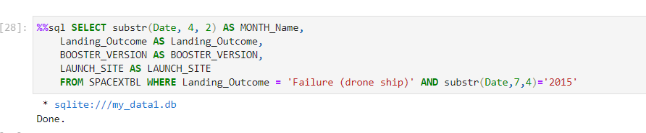
2015 Launch Records
We used a combinations of the WHERE clause, LIKE, AND, and BETWEEN
conditions to filter for failed landing outcomes in drone ship, their booster
versions, and launch site names for year 2015

Slide 33
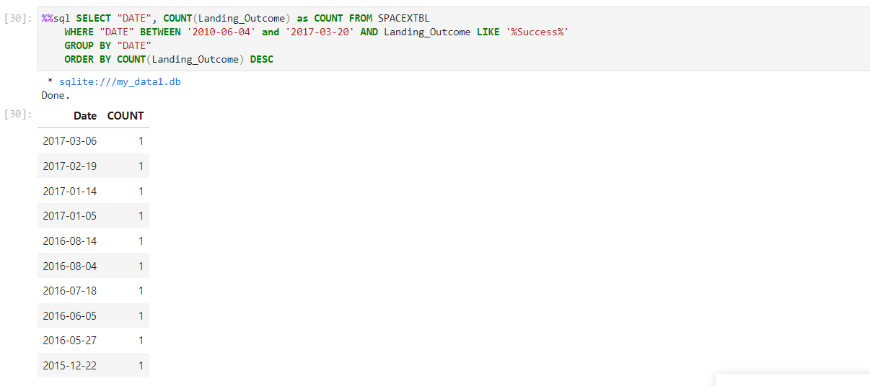
Rank Landing Outcomes Between 2010-06-04 and 2017-03-20
We selected Landing outcomes and the COUNT of landing
outcomes from the data and used the WHERE clause to
filter for landing outcomes BETWEEN 2010-06-04 to
2010-03-20.
We applied the GROUP BY clause to group the landing
outcomes and the ORDER BY clause to order the grouped
landing outcome in descending order

Slide 34

Section 3

Slide 35

<Folium Map Screenshot 1>
We can see that
all the SpaceX
launch sites are
located inside
the United
States

Slide 36
<Folium Map Screenshot 2>

Slide 37



<Folium Map Screenshot 3>
Using KSC LC-39A as an example, launch sites are very close to railways for large part and supply transportation. Launch sites are close to highways for human and supply transport. Launch sites are also close to coasts and relatively far from cities so that launch failures can land in the sea to avoid rockets falling on densely populated areas.

Slide 38

Section 4

Slide 39
<Dashboard Screenshot 1>
This is the distribution of successful landings across all launch sites. CCAFS LC-40 is the old name of CCAFS SLC-40 so CCAFS and KSC have the same amount of successful landings, but a majority of the successful landings where performed before the name change. VAFB has the smallest share of successful landings. This may be due to smaller sample and increase in difficulty of launching in the west coast.

Slide 40
<Dashboard Screenshot 2>
KSC LC-39A has the highest success rate with 10 successful landings and 3 failed landings.

Slide 41

<Dashboard Screenshot 3>
Plotly dashboard has a Payload range selector. However, this is set from 0-10000 instead of the max Payload of 15600. Class indicates 1 for successful landing and 0 for failure. Scatter plot also accounts for booster version category in color and number of launches in point size. In this particular range of 0-6000, interestingly there are two failed landings with payloads of zero kg.

Slide 42

Section 5

Slide 43

Classification Accuracy
All models had virtually the same accuracy on the test set at 83.33% accuracy. It should be noted that test size is small at only sample size of 18.
This can cause large variance in accuracy results, such as those in Decision Tree Classifier model in repeated runs.
We likely need more data to determine the best model.

Slide 44

Confusion Matrix
Since all models performed the same for the test set, the confusion matrix is the same across all models. The models predicted 12 successful landings when the true label was successful landing.
The models predicted 3 unsuccessful landings when the true label was unsuccessful landing.
The models predicted 3 successful landings when the true label was unsuccessful landings (false positives). Our models over predict successful landings.

Slide 45
Conclusions
We can conclude that:
• The Tree Classifier Algorithm is the best Machine Learning approach for this dataset.
• The low weighted payloads (which define as 4000kg and below) performed better
than the heavy weighted payloads.
• Starting from the year 2013, the success rate for SpaceX launches is increased,
directly proportional time in years to 2020, which it will eventually perfect the
launches in the future.
• KSC LC-39A have the most successful launches of any sites; 76.9%
• SSO orbit have the most success rate; 100% and more than 1 occurrence.

Slide 46
Appendix
Include any relevant assets like Python code snippets, SQL queries, charts, Notebook outputs, or data sets that you may have created during this project

Slide 47


